Slide 1
Classification of ncRNAs using machine learning methods
Henning Wehrmann & Stefan Simm
25.09.2019

Slide 2
Types of RNA and their specific structures

Slide 3
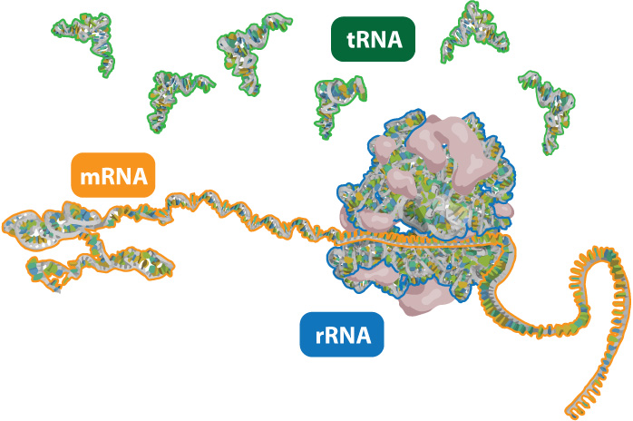
Types of RNA
http://learn.genetics.utah.edu/content/molecules/beyond/images/tmr_rna.jpg

Slide 4
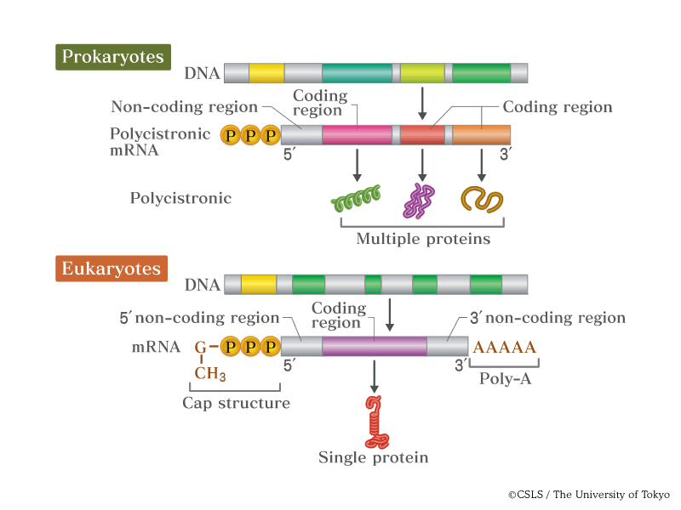
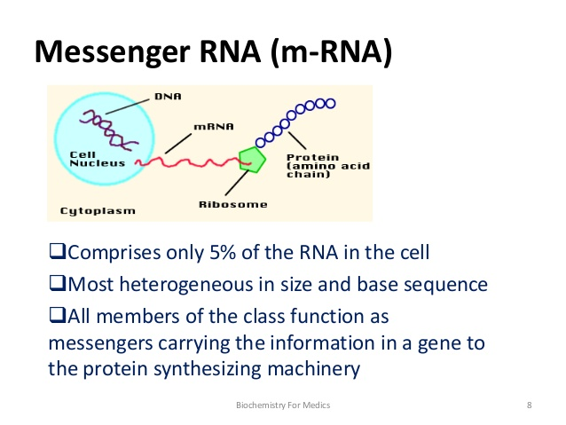
mRNA features / structure

Slide 5
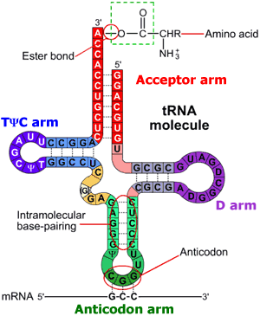
tRNA features / structure
http://www.alamy.com/search-results.asp?qt=Friedrich+Saurer+Einstein&npgs=7
Small RNA species (74 – 95 nucleotides)
Transfer amino acid to translation machinery (easily soluble RNA )
At least 20 species for 20 amino acids required
http://higheredbcs.wiley.com/legacy/college/boyer/0471661791/structure/tRNA/trna_diagram_small.gif

Slide 6
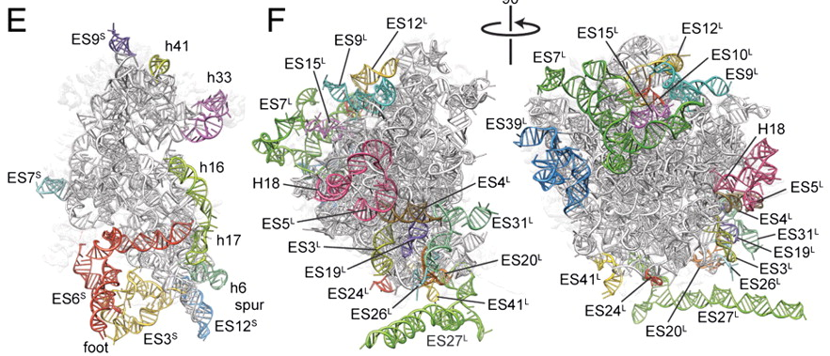
rRNA features / structure
http://www.alamy.com/search-results.asp?qt=Friedrich+Saurer+Einstein&npgs=7
http://www.pnas.org/content/107/46/19748/F3.large.jpg
Large and small ribosomal subunit:
60S → 5S, 5.8S and 28S rRNA
40S → 18S rRNA
5S is independently transcribed
All other comes from 45S precursor

Slide 7
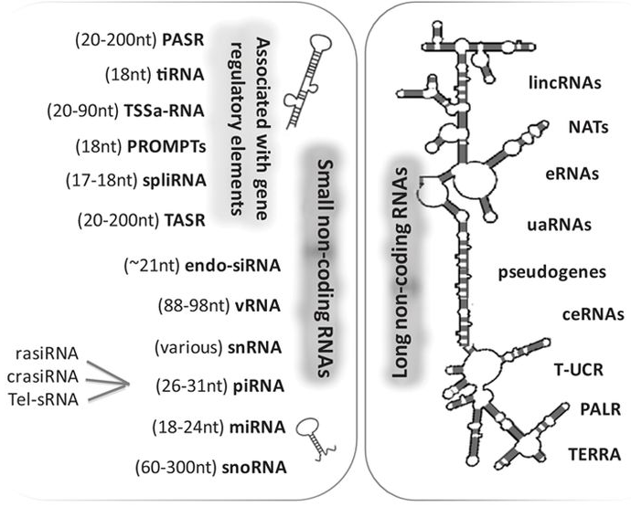
non-coding (nc) RNAs
Schonrock N et al. Circulation Research. 2012;111:1349-1362
Notes:
PASR: promoter-associated short
tiRNA: transcription initiation
TSSa-RNA: transcription start site-associated
PROMPT: promoterupstream transcripts
spliRNA: splice junction-associated
vRNA: vault
rasiRNA: repeat associated small interfering
crasiRNA: centromere repeat associated short interacting
Tel-sRNA: telomere specific small
lincRNA: long intergenic non-coding
Nat: natural antisense transcripts
eRNA: enhancer RNA
uaRNA: 3ÙTR-derived
ceRNA: competing endogenous
T-UCR: transcribed ultraconserved region
PALR: promoter-associated long
TERRE telomeric repeat-containing

Slide 8
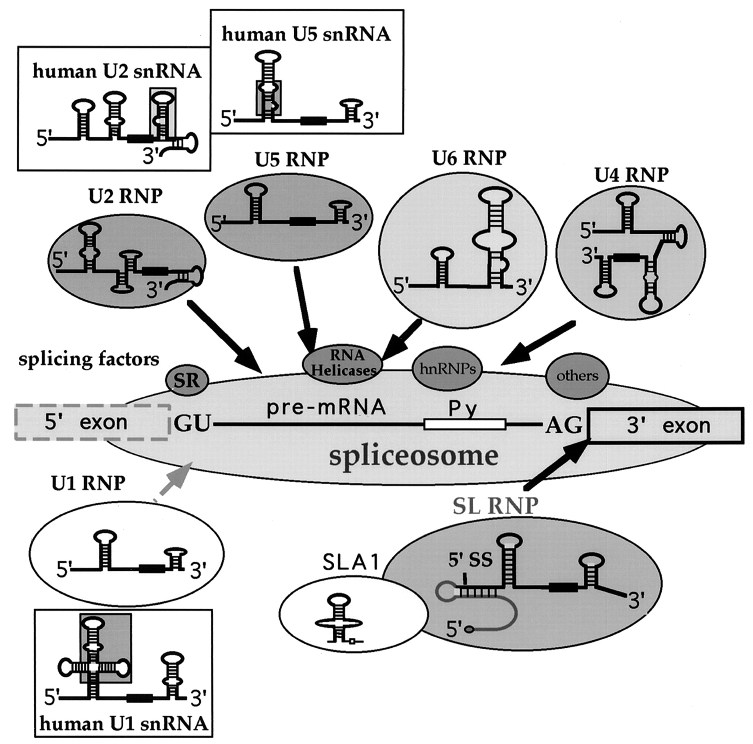
snRNAs
snRNAs
http://ec.asm.org/content/2/5/830/F2.expansion.html

Slide 9
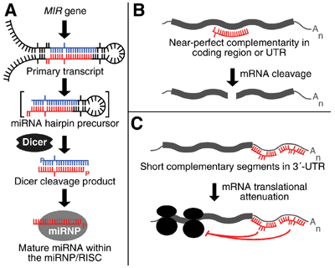
miRNAs
http://images.the-scientist.com/content/figures/images/yr2003/jun16/figure.gif

Slide 10
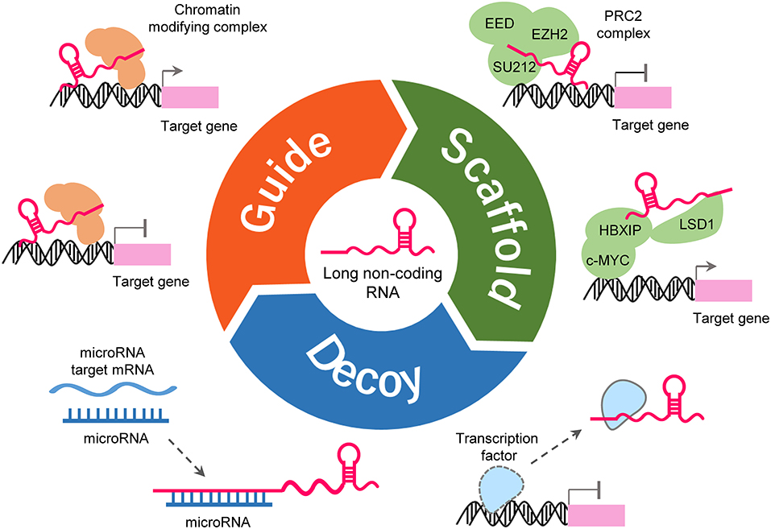
Long non-coding RNA
> 200 nt long
Many known in Mammals
Only few characterized in Plants (7)
Low inter-species sequence conservation
Structural conservation for maintaining function
(Dong P et al. 2018 Frontiers in Genetics)

Slide 11
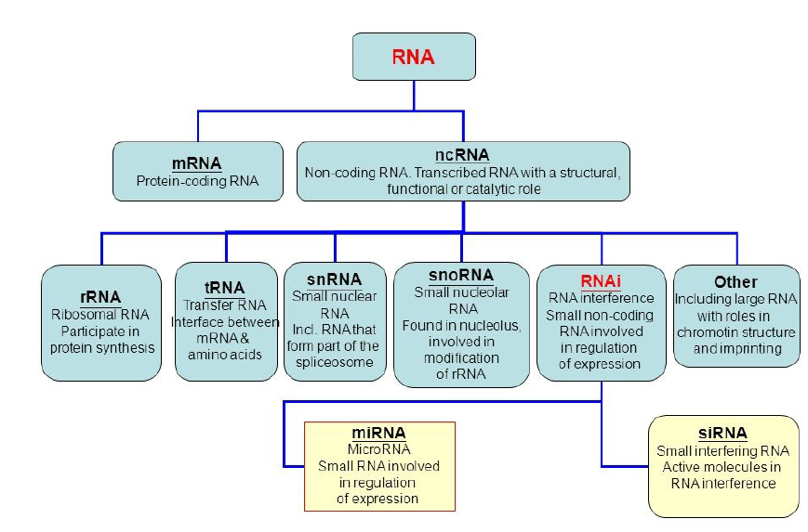
Non-coding RNA
http://slideplayer.com/slide/7959310/25/images/2/Type+of+RNA+molecules+RNA+ncRNA+mRNA+snRNA+snoRNA+tRNA+RNAi+Other+rRNA.jpg

Slide 12
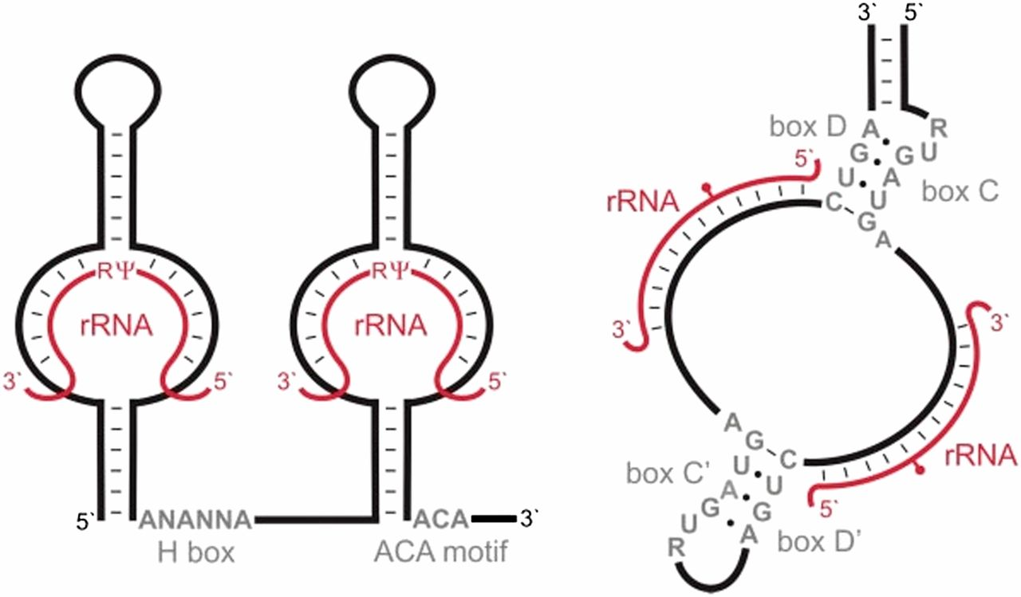
snoRNAs
2′-O-ribose methylation
Pseudouridylation
http://www.genetics.org/content/genetics/195/3/643/F6.large.jpg

Slide 13
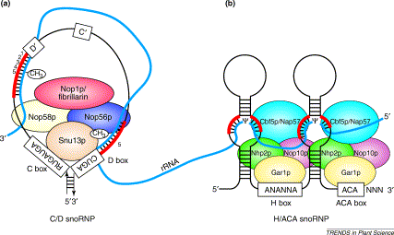
snoRNAs
http://www.alamy.com/search-results.asp?qt=Friedrich+Saurer+Einstein&npgs=7
2′-O-ribose methylation
Pseudouridylation
http://www.cell.com/trends/plant-science/fulltext/S1360-1385%2802%2900007-9

Slide 14
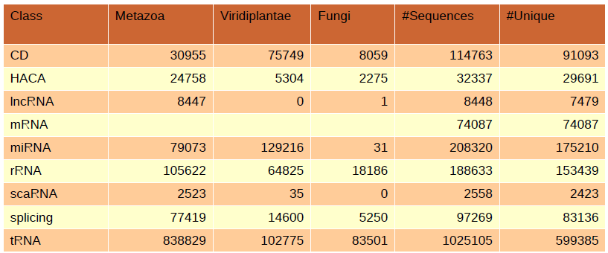
The dataset
8 classes of ncRNA from Rfam from 3 kingdoms
Arabidopsis thaliana mRNA from NCBI refseq
No hypotheticals, no partials
downsampled via CD-HIT to max 0.9 identity

Slide 15
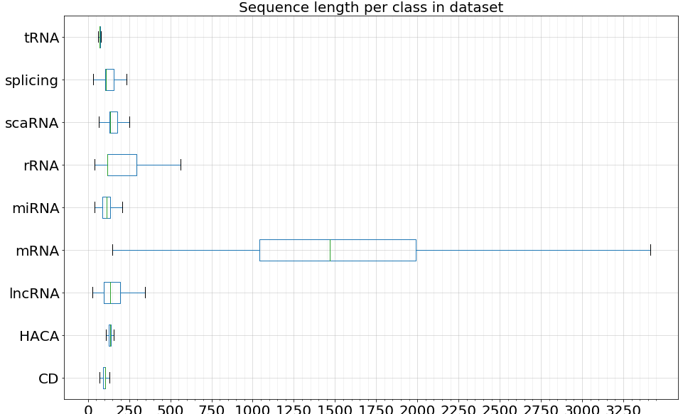
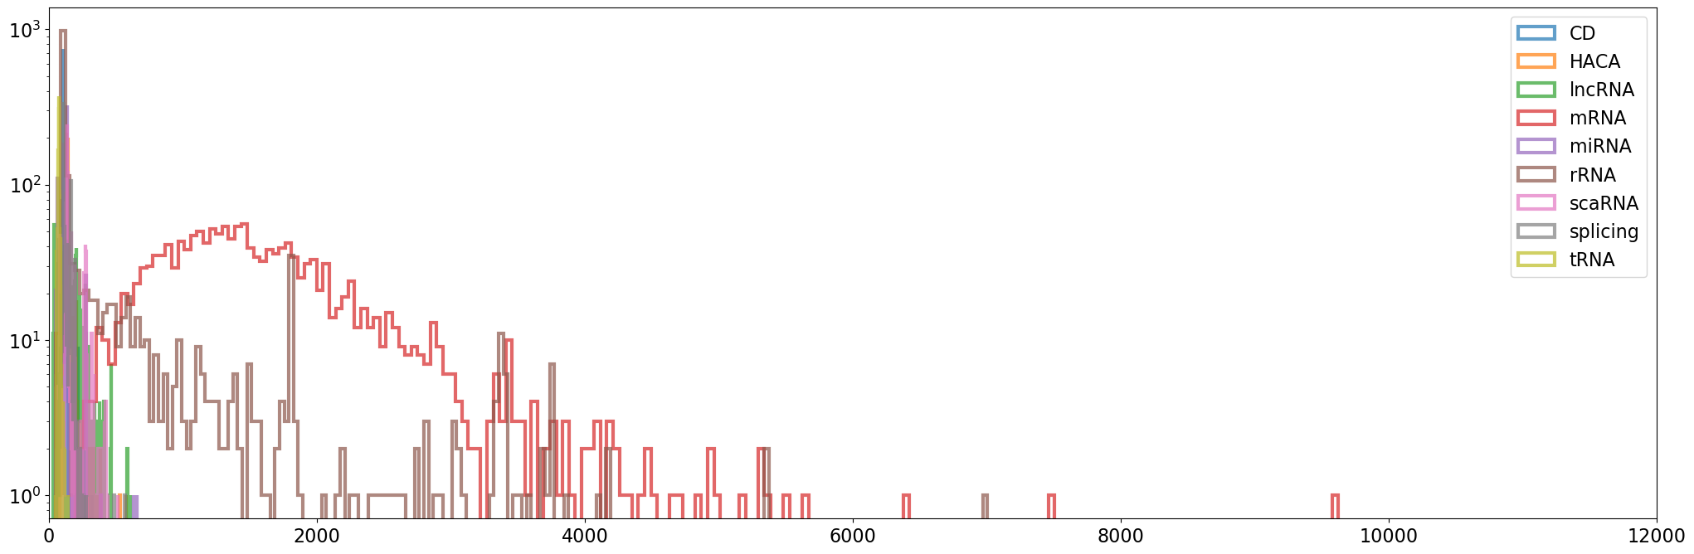
#Seqs
599385
83136
2423
153439
175210
74087
7479
29691
91093

Slide 16
Workflow
Get data
Inspect data
Split data into Train / Test sets
Create model
Train model
Test model
Repeat until satisfied
Run 10-fold cross validation
Use “real world” data
Assess classification results
Look for features

Slide 17
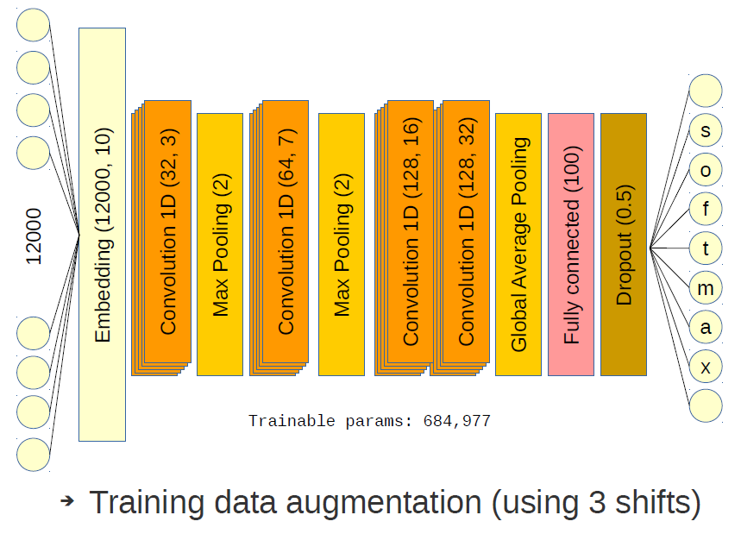
CNN Architecture

Slide 18
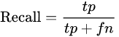
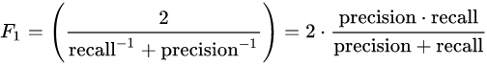
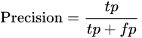
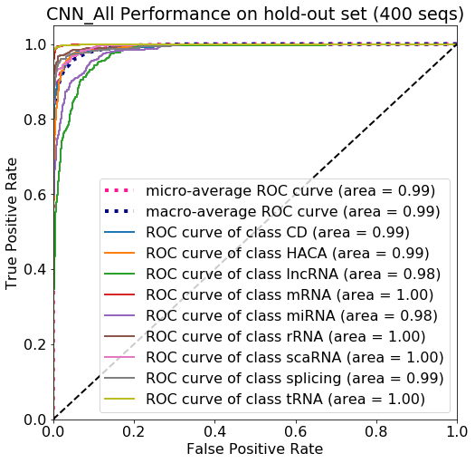
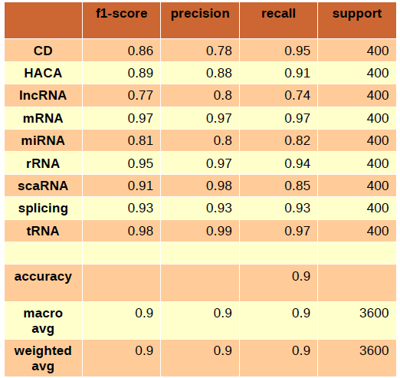
Test results

Slide 19

Thank you

